Slide 1
Preliminary Presentation:
De-Aerating Solutions for Cataracts Surgeries
Brandon Lum

Slide 2
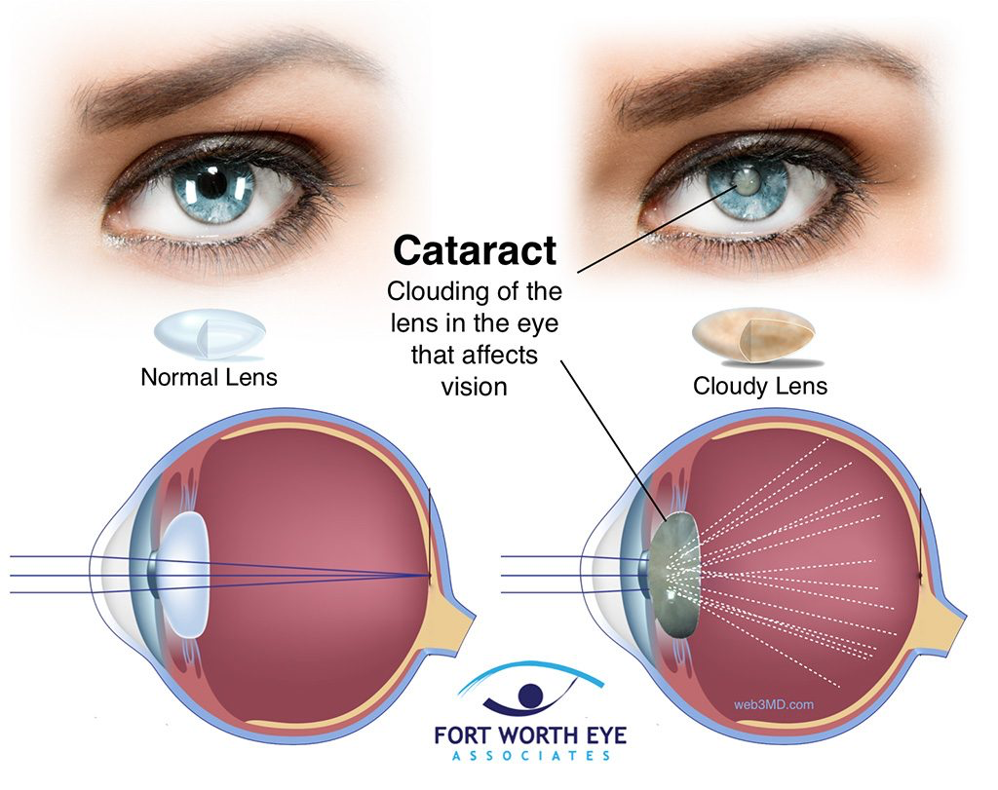
Cataracts: Impact & Market
Hardening of the lens of the eye
Cloudy vision, halos, blindness
Half of all blindness
Age, trauma, radiation, genetics, smoking
Treated by surgery
20 million people worldwide
US: $6.8 billion/year
Cataract diagram (1).

Slide 3
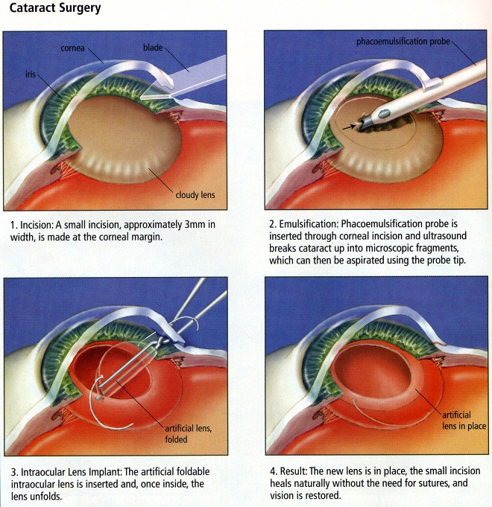
Phacoemulsification (Phaco) Surgery
~$2000/eye
10 - 20 minutes
3.6 million surgeries/ year worldwide
US: 2 million surgeries/year
Simplified steps:
Incision
Emulsification
Implantation
Phaco surgery steps (2).

Slide 4
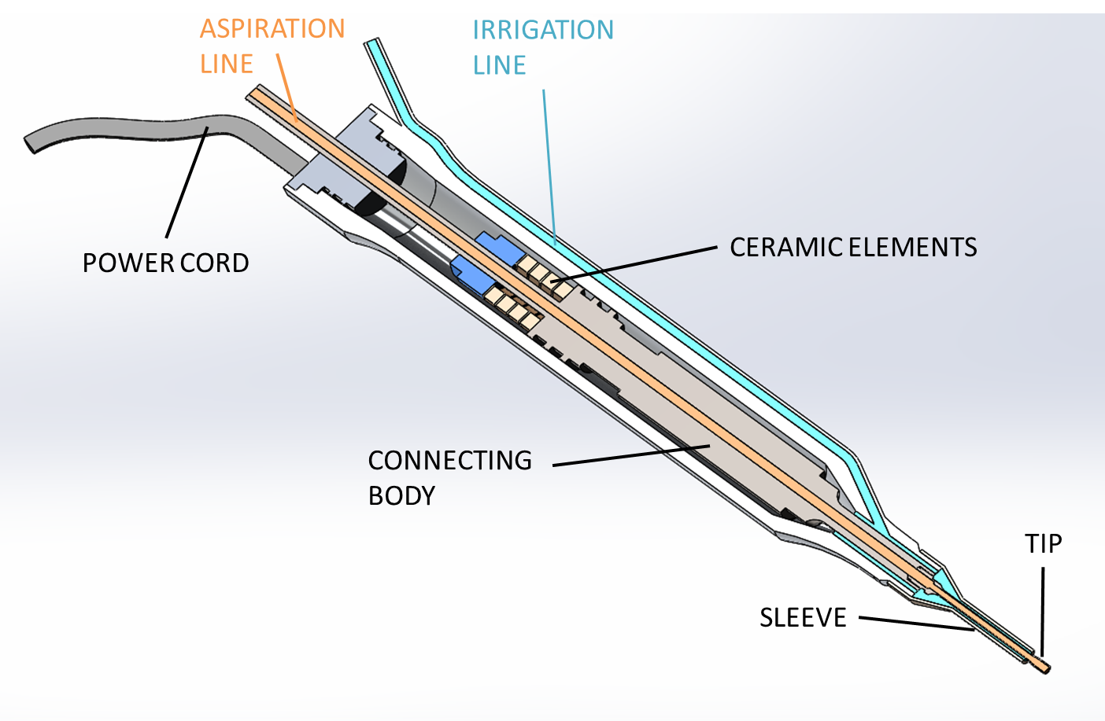
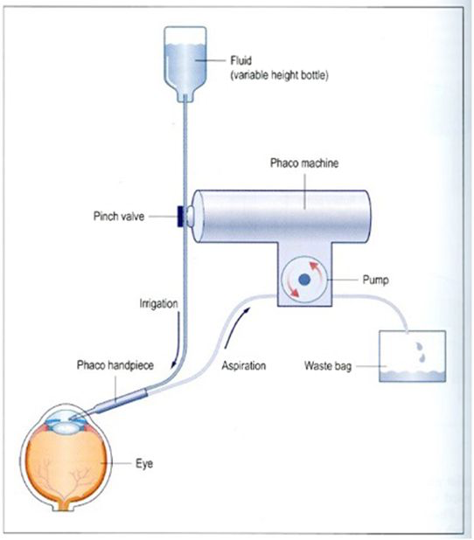
Phaco Handpiece & System
Needle Tip Vibrates Ultrasonically
Cavitation Shockwaves
Jackhammer Effect
Irrigation (Inflow)
Aspiration (Vacuum)
System:
Controls:
Flow
Vacuum
Power
Phaco Handpiece (3).
Simple Phaco Machine (4).

Slide 5
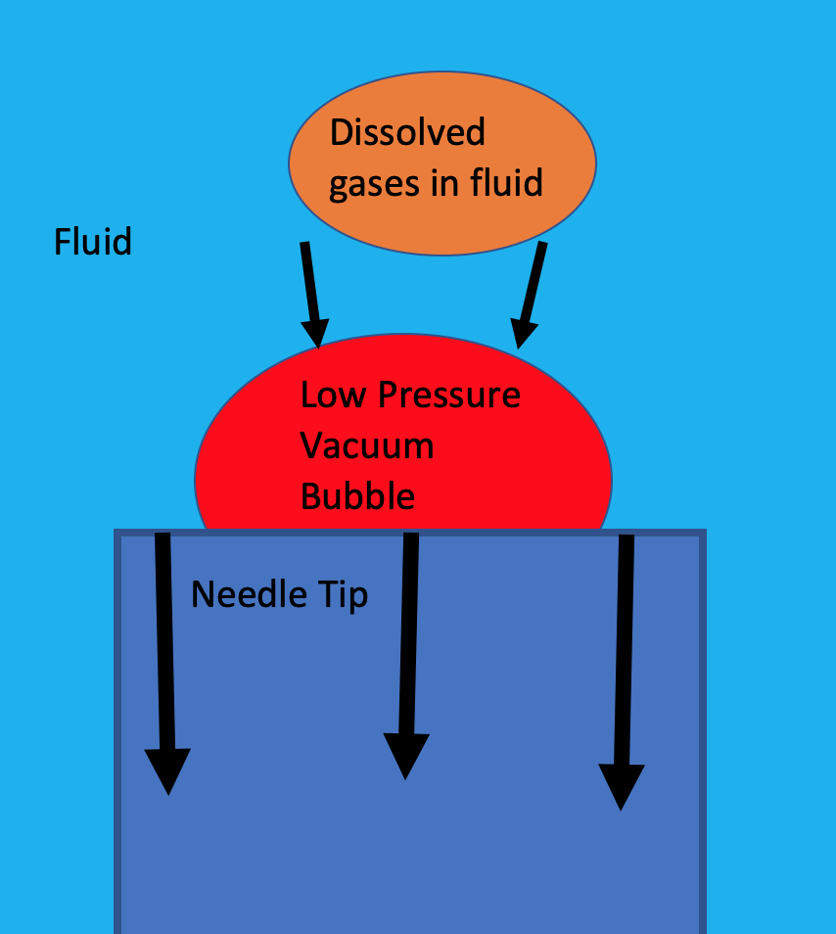
Phaco: Bubble Formation & Problems
Movement of the needle tip creates low pressure areas of vacuum
Cavitation/vacuum areas pull gas from fluid
Problems:
Obscure surgeon vision
Can cause cornea damage
Can lead to longer and riskier surgeries
Formation of bubbles (5).

Slide 6
Need Statement & Project Scope
Build a device to de-aerate the Balanced Salt Solution (BSS) for use in phacoemulsification cataract removal surgeries to prevent gas bubbles from forming.
Our device is to be attached between the fluid container and the phaco handpiece. This device is expected to be implemented in Bausch + Lomb phacoemulsification surgery systems, both already on the market and yet to be developed.

Slide 7
Design Specifications
Description | Metric | Value
Sterilize-able | Device dimensions - limited by the equipment packs in which they are stored and shipped | 12” x 6” x 6”
Inexpensive | Cost of final product | $1 per unit
In- Line | Inner diameter of the openings on the device for the fluid tubes | 1.25 mm
Patient Safe | Temperature of fluid flowing out of device | 37℃ (body temperature)
Consistency During Surgery | Minimum flow rate | 20 ml/min
Efficiency | Dissolved O2 concentration in fluid flowing out of device | < 55%

Slide 8
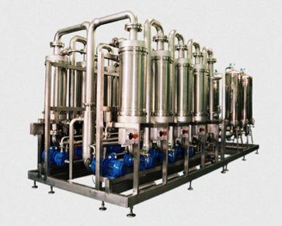
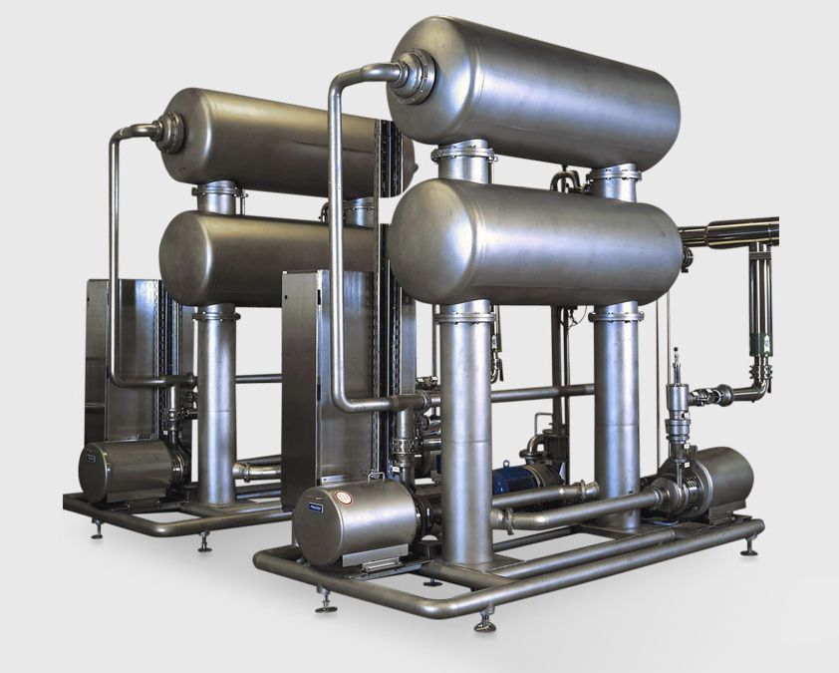
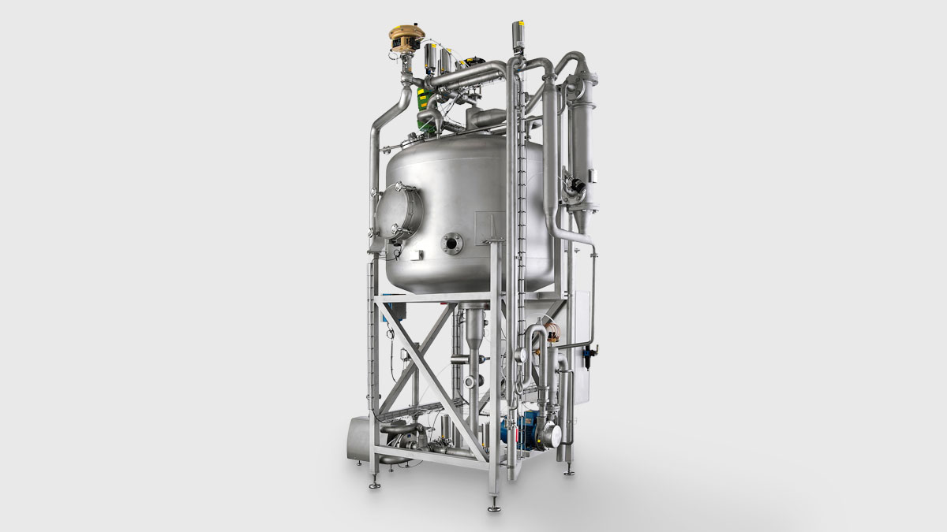
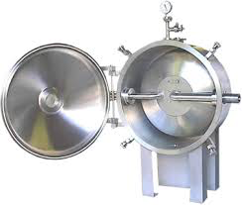
Existing Solutions
Method | Feasibility
Substitution by inert gas | - Violates sterile procedure - Contaminates solution
Addition of reactant
Thermal regulation | - Time-consuming - Unsafe temperatures - Large mechanisms
Freeze-pump-thaw cycling
Pressure reduction | - Feasible - Miniaturize-able
Membrane degasification
Ultrasonic degasification
De-aerators on the market (6).

Slide 9
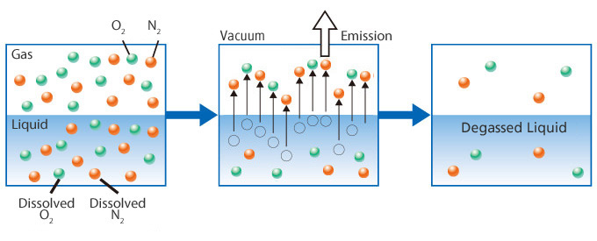
Pressure Reduction
Vacuum in contact with solution surface area
Gas pulled from liquid to vacuum
Simple
Can be done to flowing liquid
Requires vacuum
Time and efficiency scale with size and vacuum
Contamination risk
Presently used for resins
Method of pressure reduction degasification (7).

Slide 10
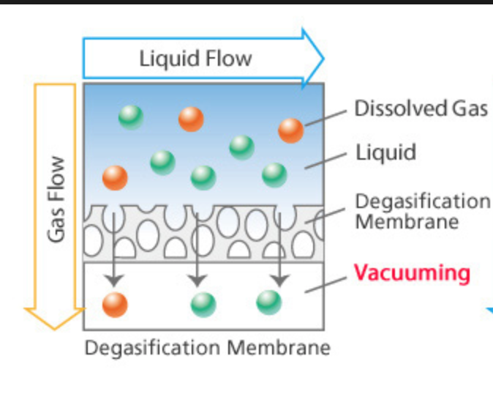
Membrane Degasification
Liquid in contact with membrane only permeable to gas in contact with vacuum
Gas pulled across membrane from liquid to vacuum
Time and efficiency scale with size and vacuum
Membrane prevents contamination risk
Supports a greater flow rate
Presently used in factory settings
Membrane Degasification (7).

Slide 11
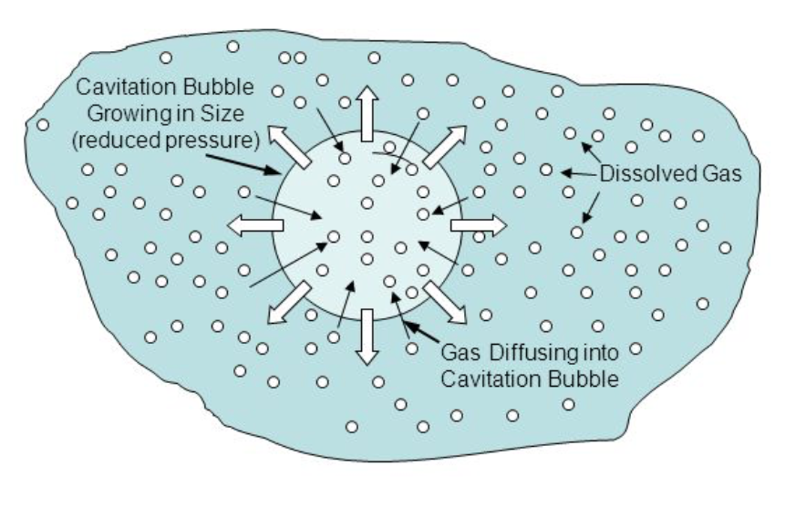
Ultrasonic Degasification
Creating low pressure areas to draw out gases
Requires vacuum
Requires ultrasonic power
Time and efficiency scales with power/frequency
Same effect that causes bubbling during phaco surgery
Presently used for oils
Ultrasonic Degasification (8).

Slide 12
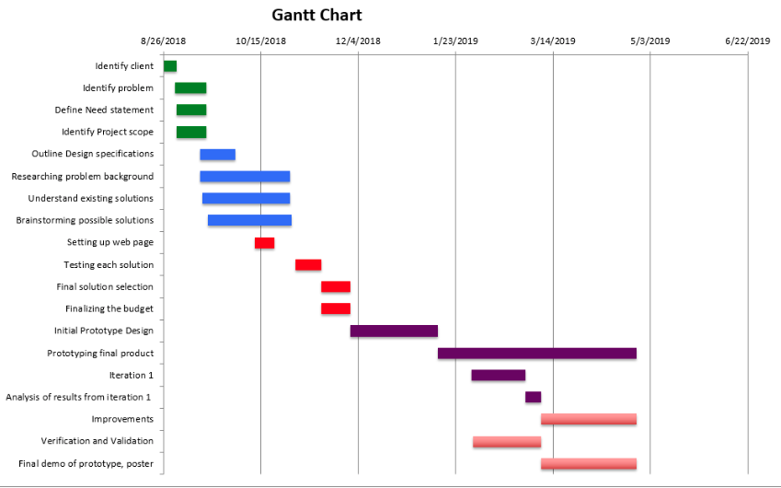
Gantt Chart

Slide 13
Team Organization
Name | Brandon Lum | Anupama Melam | Michael Morgan
Responsibilities | - Communicating with the client, Brian McCary - Lab experimentation - Obtaining materials - Researching vacuums - Prototype testing | - Maintaining project website - Researching sterilization processes - Updating Gantt Chart - Keeping notes for composing weekly reports | - Researching existing solutions - Communicating with Professor Klaesner - Updating class schedule - Researching material pricing

Slide 14
Sources
Khazaeni, Leila. “Cataract - Eye Disorders - Merck Manuals Consumer Version.” Merck Manuals Professional Edition, 2018, www.merckmanuals.com/home/eye-disorders/cataract/cataract.
eye. “PHACO, CATARACT EYE SURGERY.” Phaco, Cataract Eye Surgery, Dec. 2017, advancedcentreforeyes.com/blog/phaco-cataract-eye-surgery/.
Benjamin, L. “Fluidics and Rheology in Phaco Surgery: What Matters and What Is the Hype?” Nature News, Nature Publishing Group, 19 Jan. 2018, www.nature.com/articles/eye2017299.
Concord Eye Center. “Cataract Portal.” Concord Eye Center, 2017, concordeyecenternh.com/services-procedures/cataracts/.
Wilkie, David A. “Principles of Phacoemulsification.” Ohio State University , Ohio State University Veterinary Medical Center, 2018, cvm.ncsu.edu/wp-content/uploads/2018/05/June-21_Wilkie_Phaco-Dynamics-Slides.pdf.
SeekPart.com. “Vacuum Degasser.” Global Mechanical Parts Trading Network, SeekPart.com, 2018, www.seekpart.com/hydraulic-pneumatic/pumps/Vacuum+Degasser.html.
Separel Technology. “What Is Degasification & Aeration?” What Is Degasification & Aeration? | SEPAREL, DIC Corporation, 2018, www.separel.com/en/technology/.
Melton, Edith. “Degassing Water Supplied through Water Mains under Pressure Almost Always Contains Dissolved Air and Other Gasses. Bubbles That Form in a Glass of Water. - Ppt Download.” SlidePlayer, SlidePlayer, 2015, slideplayer.com/slide/5697342/.

